Slide 1
Tunnel Dryer, Spray Dryer, Fluidized bed Dryer
Dr. Garima Joshi
Assistant Professor, MLSU
III sem -Unit operation

Slide 2
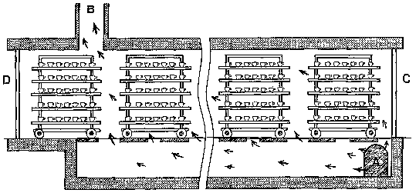
Tunnel Dryer
This dryer is variant of tray dryer. In this type
trucks are loaded with wet material at one end
of tunnel.
This tunnel comprised of a number of units each of which is electro-statically controlled.
The solid gets dried and the product is discharged at the other end of the tunnel.

Slide 3
Spray dryer
Principle:
In spray dryer the fluid to be dried is atomized into fine droplets which are thrown radially into moving stream of hot gas.
The temperature of the droplets is
immediately increased and fine droplets get
dried instantly in the form of spherical
particles.

Slide 4
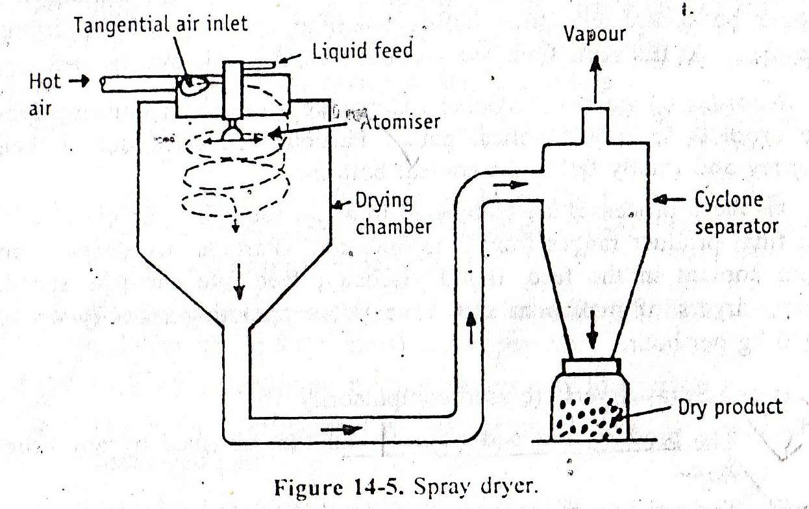
Spray dryer

Slide 5
Construction
It consist of large cylindrical drying chamber
with a short conical bottom made up of
stainless steel.(diameter 2.5 to 9.0 m and
height 25 m or more)
An inlet for hot air placed in the roof and
another inlet carrying spray disk atomizer is
also set in the roof. The spray disk atomizer is about 300 mm in diameter and rotates at a speed of 3000 to 50,000 rpm.
Bottom of the dryer is connected to cyclone
separator.

Slide 6
Working
Drying of material in spray dryer involves 3 stages;
1. Atomization of liquids: The feed is introduced through the atomizer either by gravity or using suitable pump.
2. Drying of the liquid droplets: Fine droplets are dried in the drying chamber by supplying hot air through the inlet.
3. Recovery of the dried product: Centrifugal force
of atomizer drives the droplets to follow helical path. Particles are dried and collected at the conical bottom.
All these processes are completed in few seconds. Particle size obtained is ranging from 2 to 500 mm. maximum size of spray dryer has capacity of 2000 kg per hour.

Slide 7
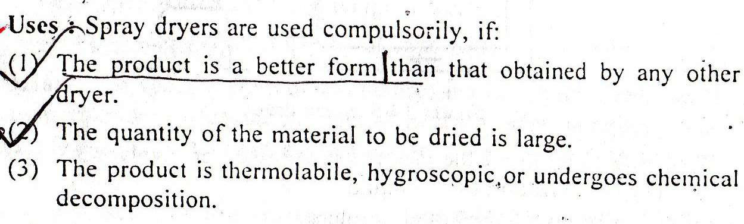
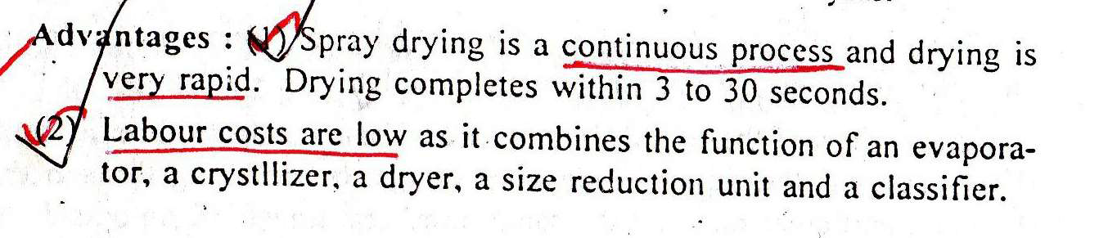
Uses

Slide 8
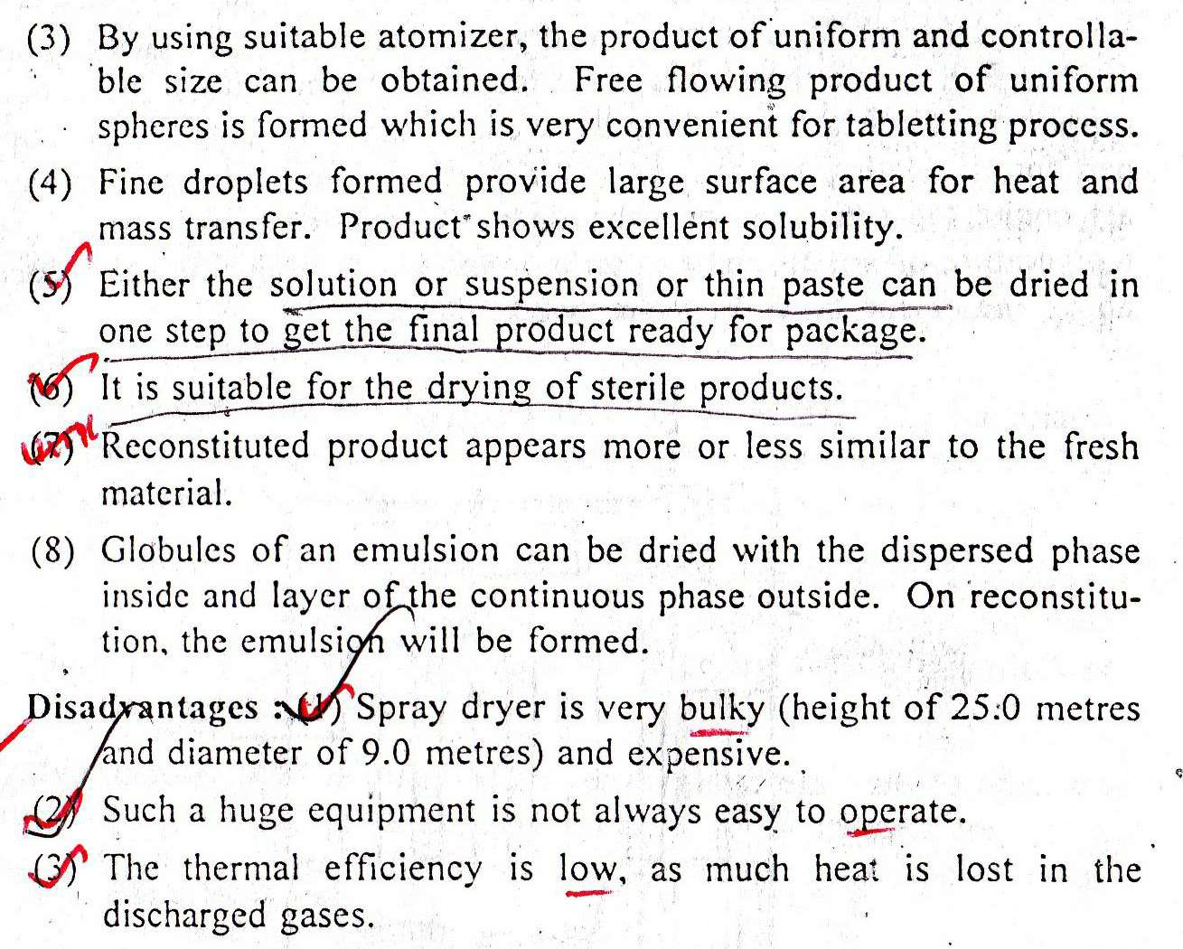
Uses

Slide 9
Principle:
In fluidised bed dryer hot air is passed at high
pressure through a perforated bottom of the
container.
The granules are lifted from the bottom and
suspended in the stream of air, this condition
is called as fluidized state.The hot gas surrounding every granule to completely dry them.

Slide 10
Construction
Fluidised bed dryer is available in two forms;
i) Horizontal FBD ii) Vertical FBD
The dryer is made up of SS or plastic.
A detachable perforated bowl is placed at the
bottom of the dryer which is used for charging
and discharging of material. A fan is mounted in the upper part for circulating hot air.
Fresh air inlet, pre-filter and heat exchanger are
connected serially to the required temperature.
Bag filters are placed over bowl for recovery of
fines.

Slide 11
Working
The wet granules to be dried are placed in detachable bowl and bowl is placed into the
dryer.
Fresh air is allowed to pass through pre-filter
which subsequently gets heated by passing through heat exchanger.
Hot air passed through bottom of bowl and
fan is allowed to rotate.
The granules rise in the container because of
high velocity gas and later fall back in random motion.

Slide 12
Working
The gas surrounds every granule to completely
dry them. The air leaves the dryer by passing through bag filter.
The entrained particle remain adhere to the inside surface of bags. Periodically the bags are shaken to remove the particles.
The material is collected after some time so as to reach the ambient temperature.

Slide 13
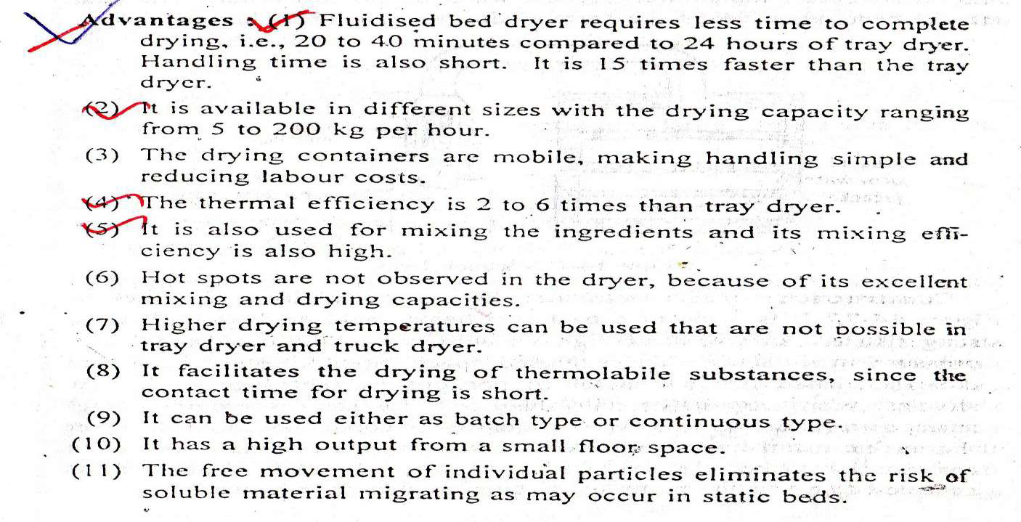
Advantages

Slide 14
Uses
Uses:
For drying granules. It can be used for drying, mixing and granulation process. It is modified for coating of granules

